Slide 1

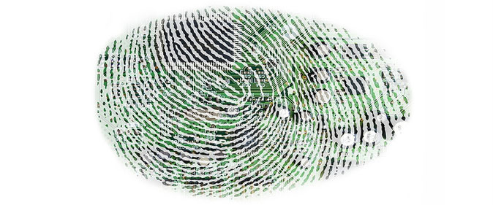
PriVaricator
Preventing Stateless Tracking on the Web
Ben Livshits (MSR)
Nick Nikiforakis (SUNY Stony Brook)

Slide 2
Involved in a number of topics
analysis of desktop and mobile applications
detection of malware
web security
augmented reality

Slide 3
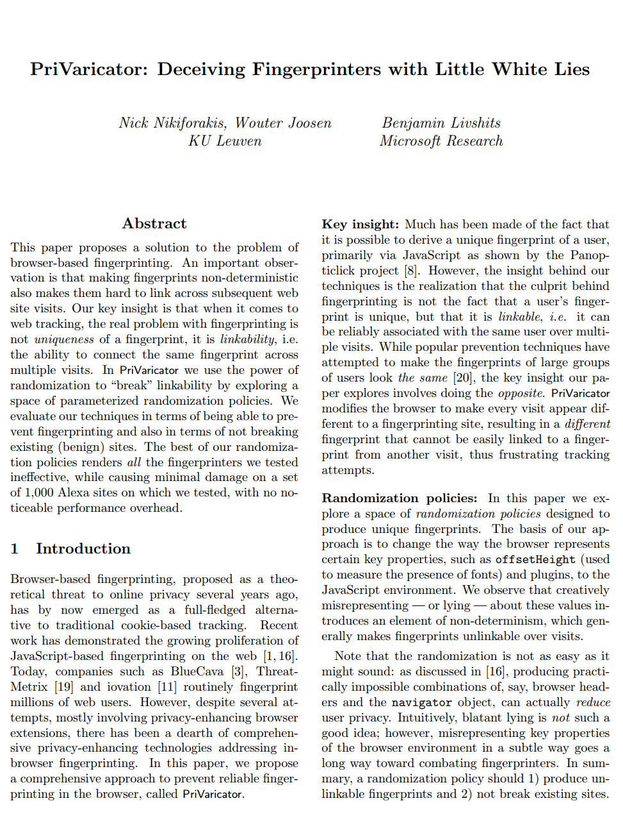
PriVaricator
Upcoming paper in WWW’15
Read it for more details

Slide 4
Cookie-based Tracking

Slide 5
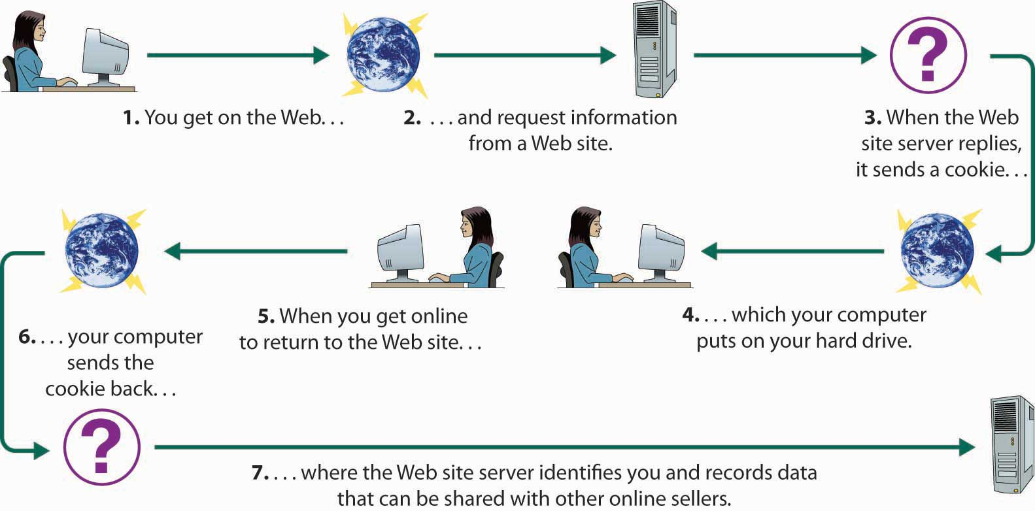
Cookies and Privacy
A key topic in Web application privacy in the last several years
The majority of focus is on cookie-based tracking

Slide 6
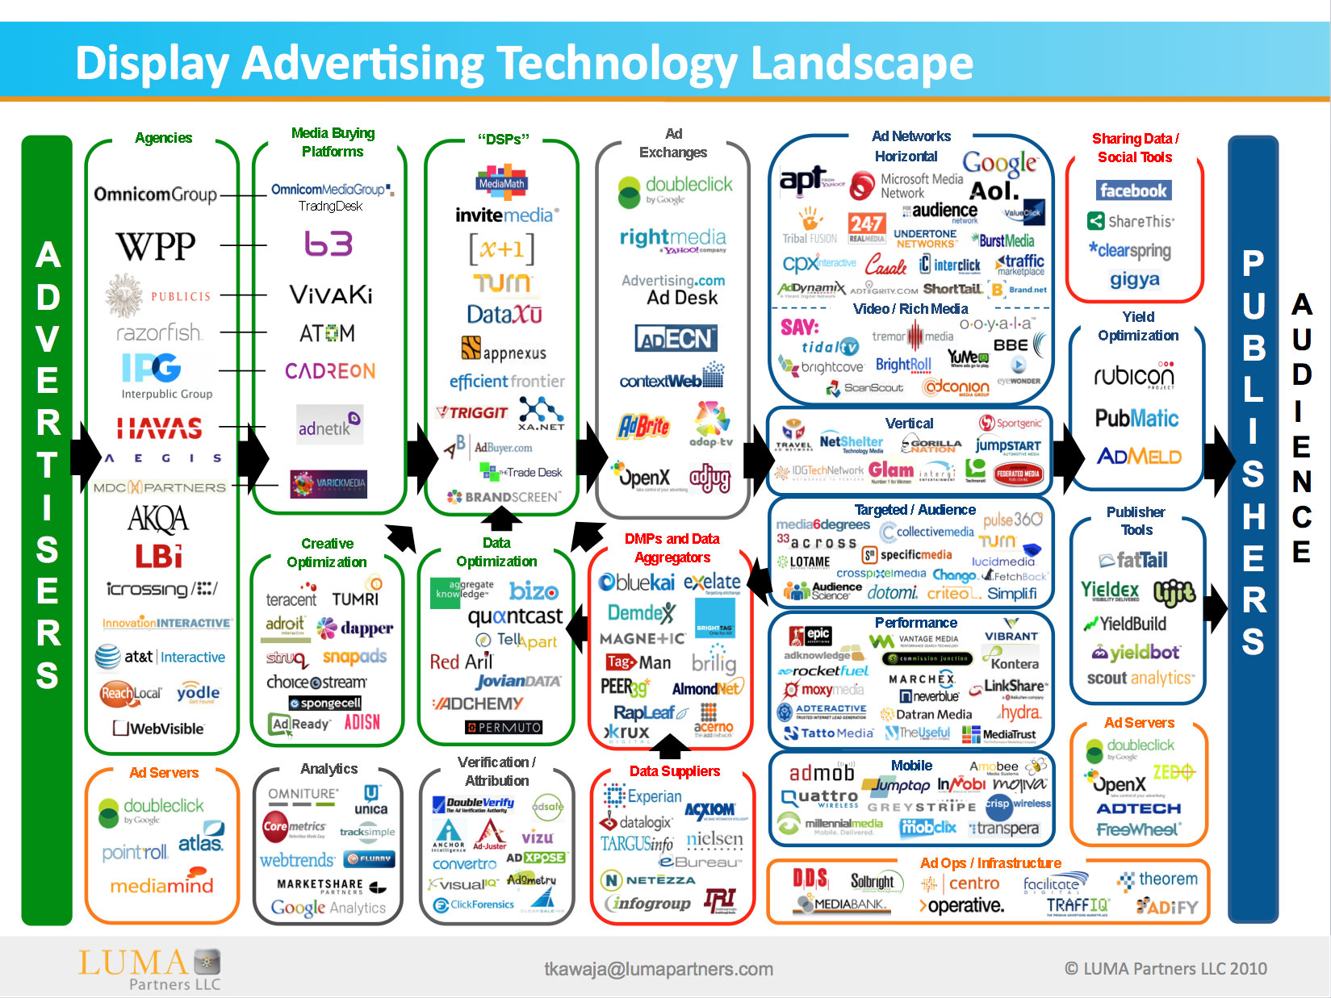
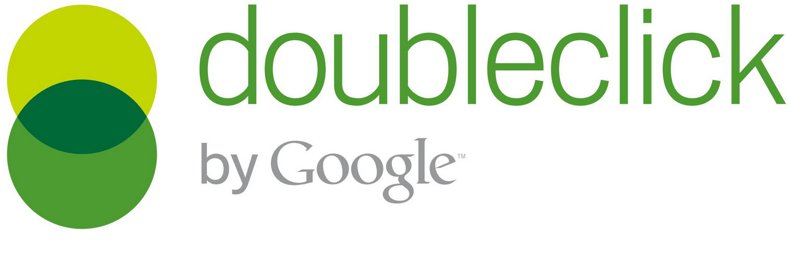
Lots and lots of advertising companies
a.com
b.com
c.com
…
z.com

Slide 7
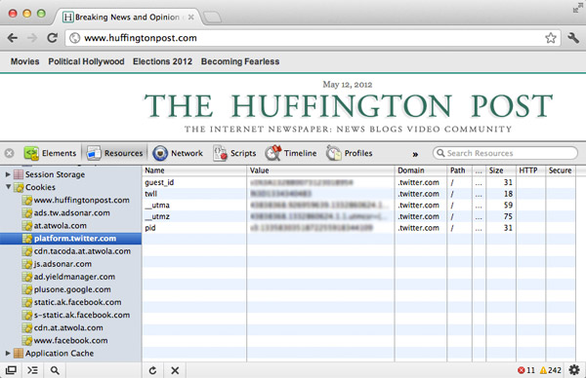
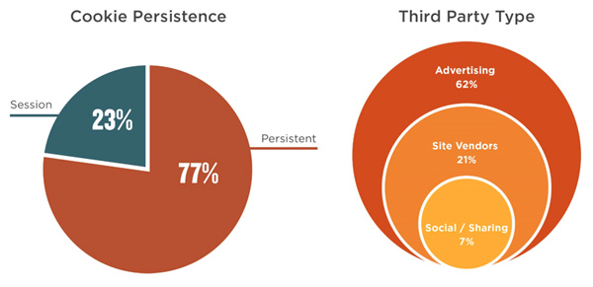
Cookies on a popular news site
truste.com

Slide 8
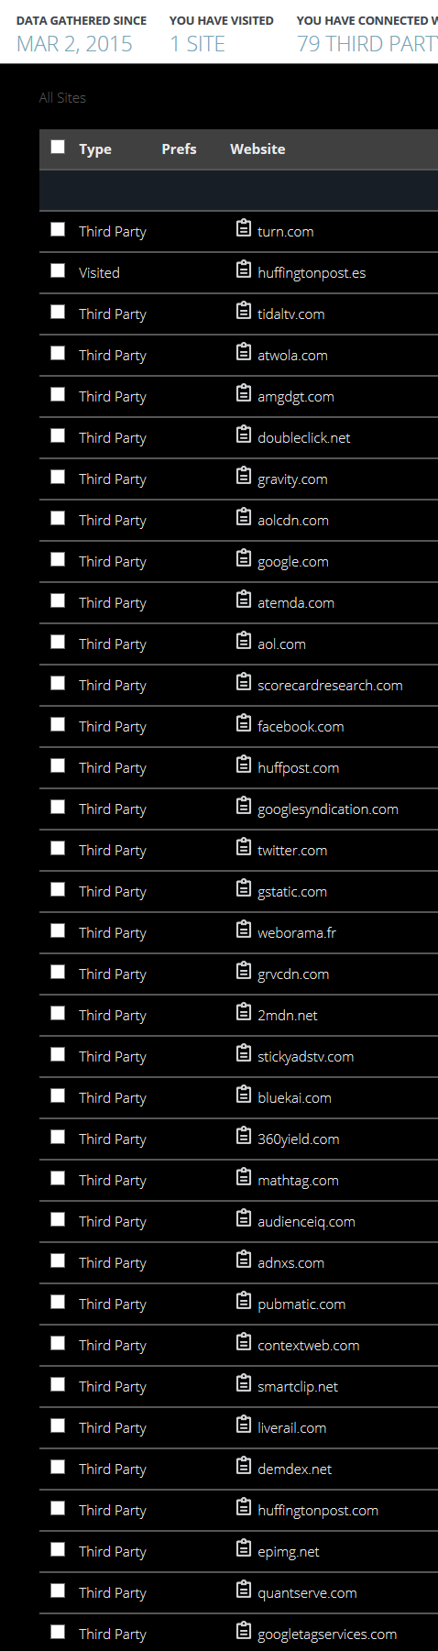
Today, a Visit to Huffingtonpost.com results in…

Slide 9
A fundamental underlying question
Why profile the user?

Slide 10
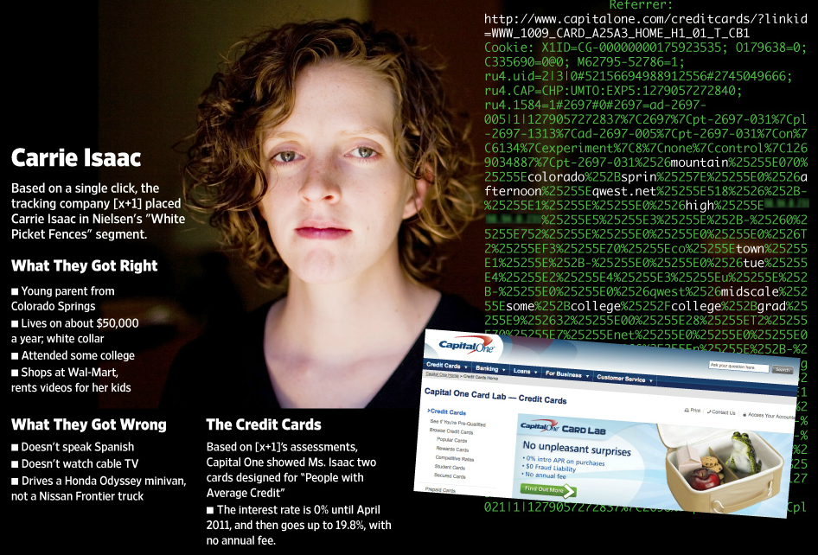
Inference based on cookies
Ad tracking company [x+1] made predictions about users based on just one website click
(from WSJ)

Slide 11
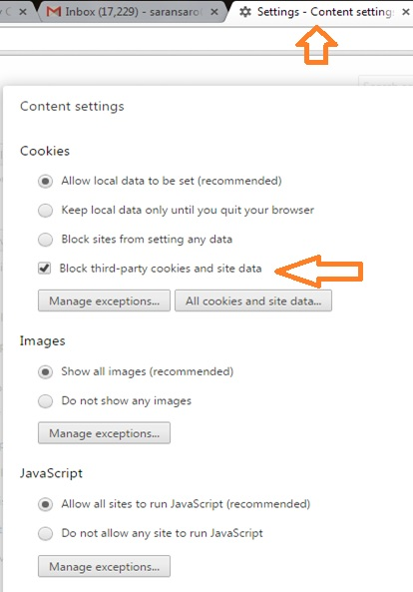
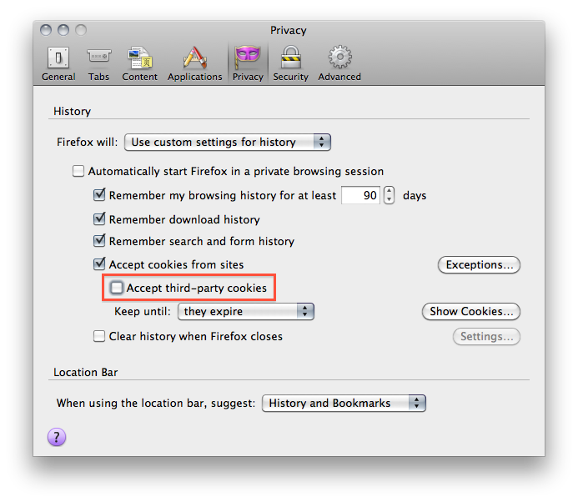
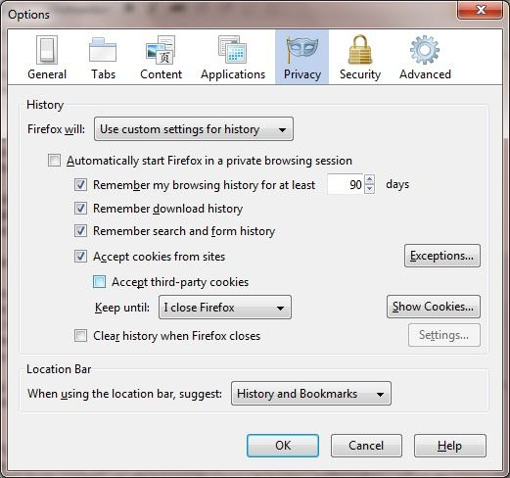
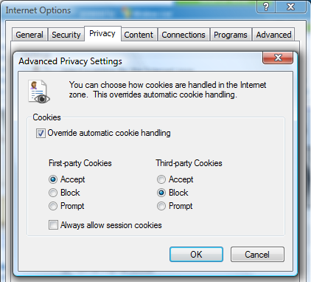
Block third-party cookies

Slide 12
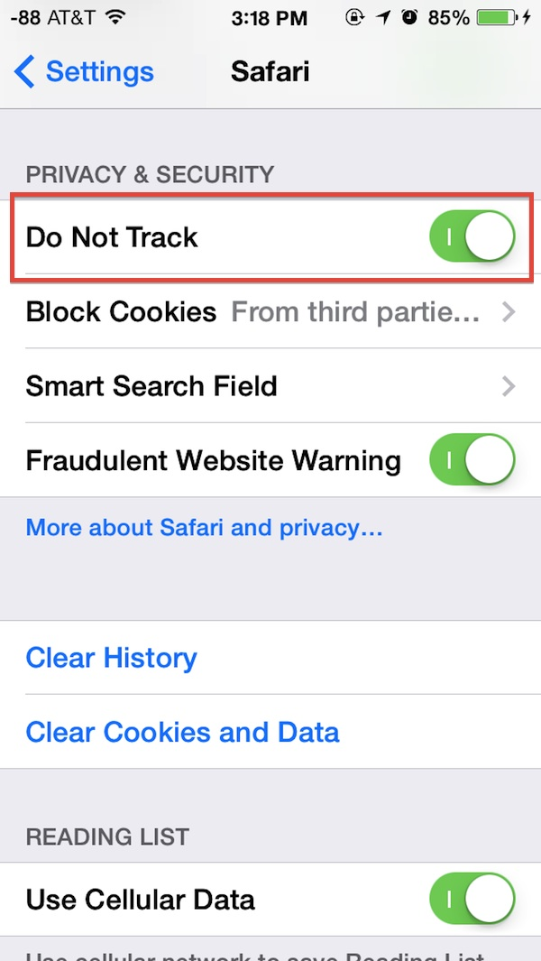
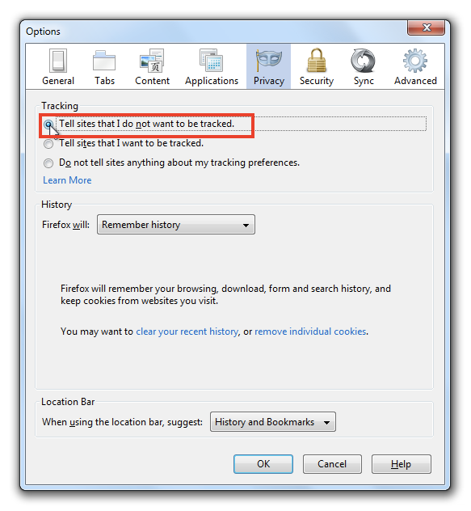
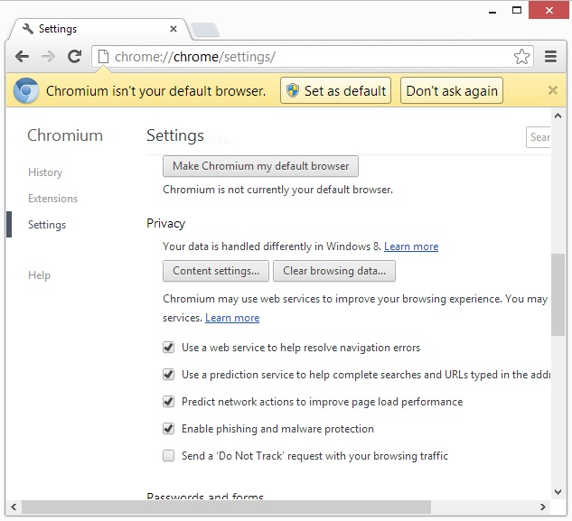
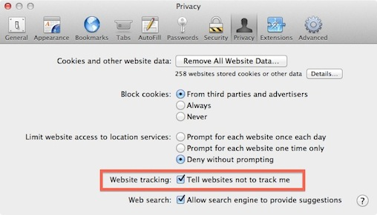
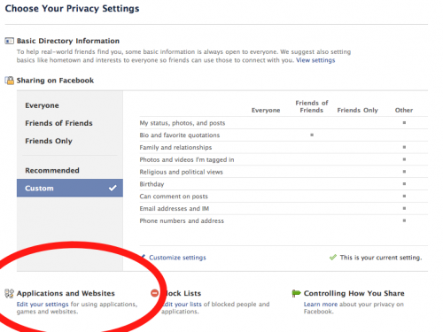
Do-NOT-TRACk initiative

Slide 13
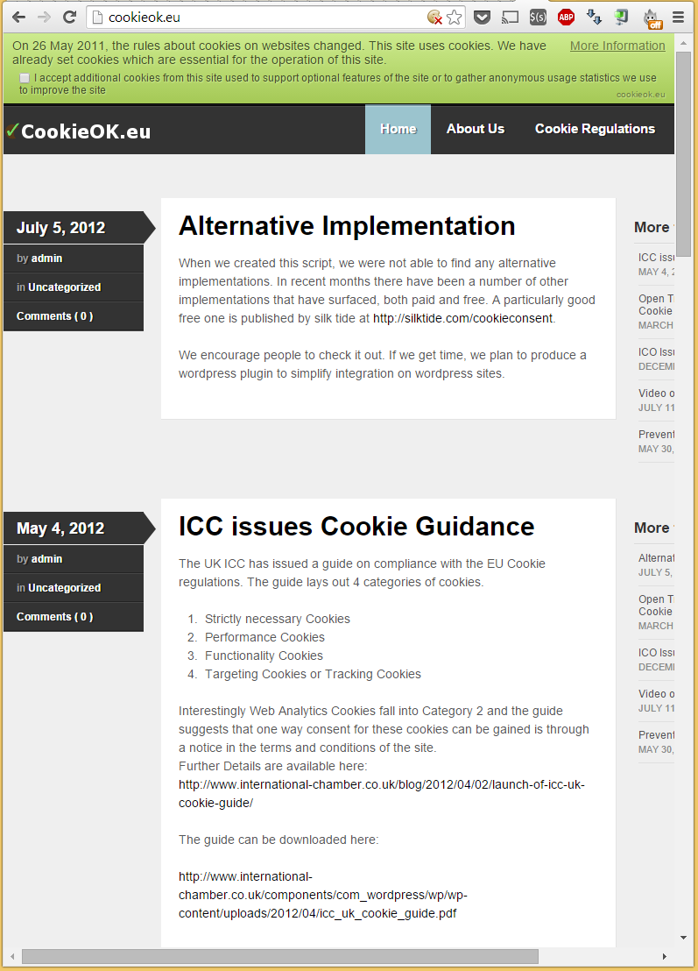
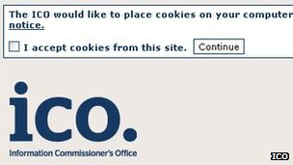

EU cookie regulations

Slide 14
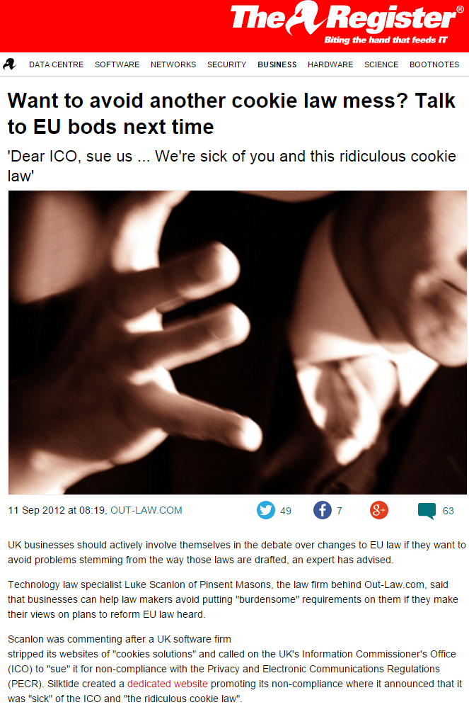
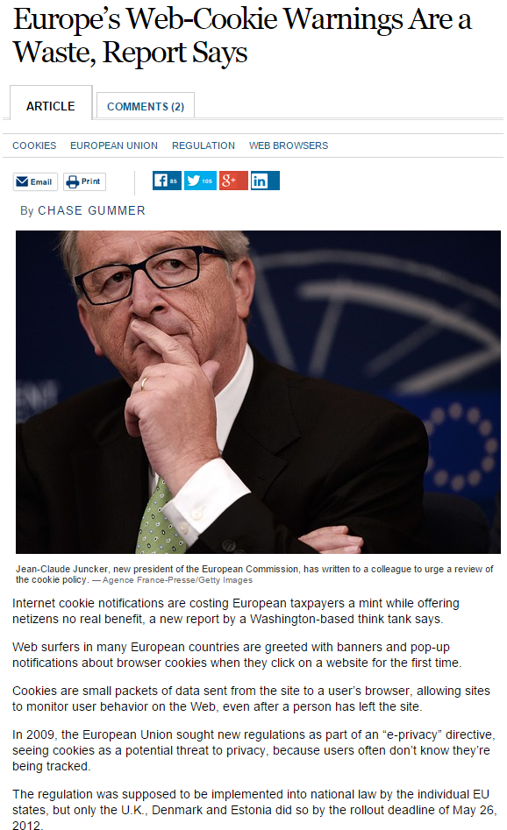
NoT everybody is fond of the cookie law

Slide 15
Stateless tracking

Slide 16
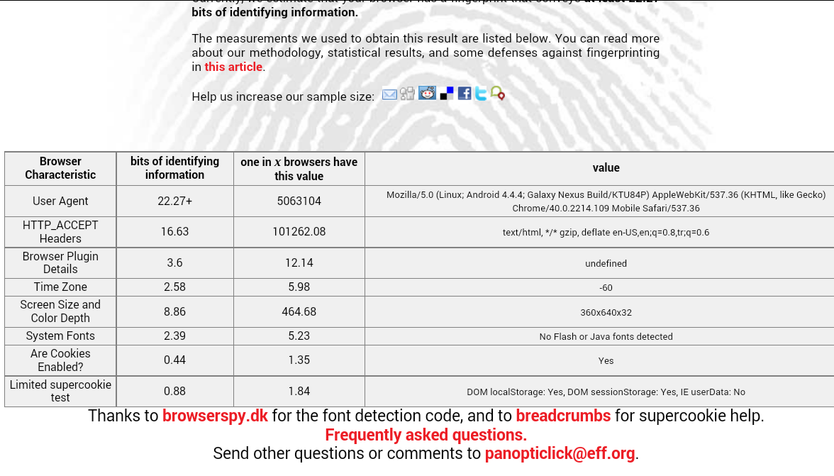
Stateless fingerprinting
Emerges around 2010 as a project from the EFF
Since then, has been replicated in various settings, including by academic researchers
In the last two years we have seen active fingerprinting from several large advertising targeting companies: BlueCava, Iovation, and ThreatMetrix
headers
plugins
fingerprint
fonts
time zone

Slide 17
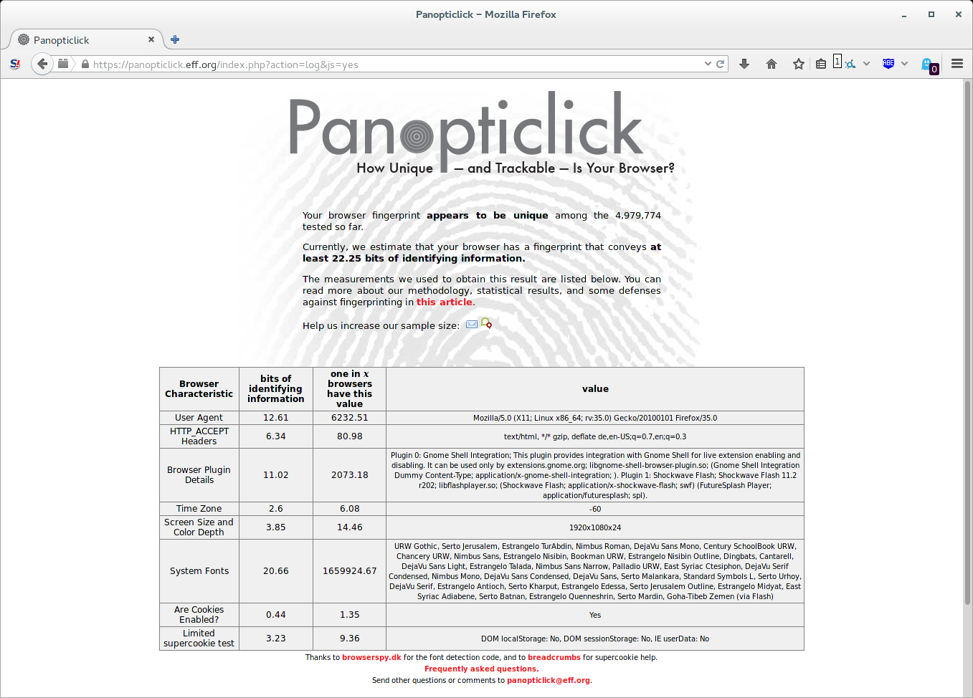
Panopticlick
Of the 470,000-plus users who had participated at that point in his public Panopticlick project, 84 percent of their browsers produced unique fingerprints
94 percent if you count those that supported Flash or Java)

Slide 18
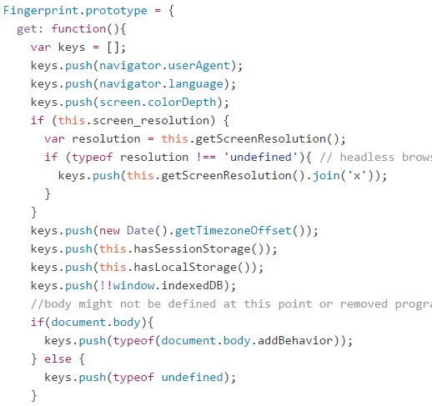
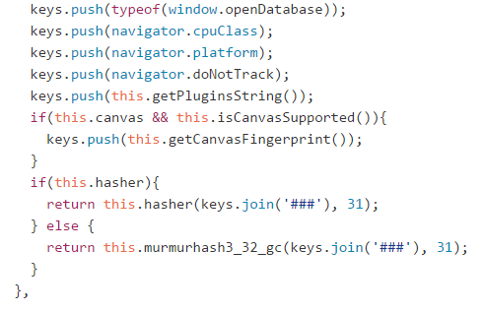
fingerprint.js: Fingerprinting lib on github

Slide 19
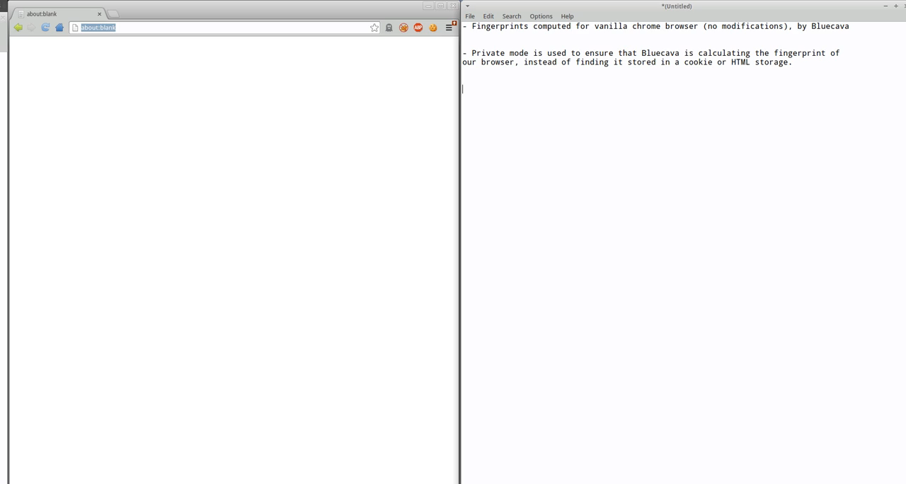
Blue Cava Fingerprinting in Action

Slide 20
Current state of fingerprinting?
Results in Cookieless monster showed that 159 of Alexa’s 10,000 most-visited websites track their users with such fingerprinting software.
Also found that more than 400 of the million most popular websites on the Internet have been using JavaScript-only fingerprinting, which works on Flash-less devices such as the iPhone or iPad.
Users continue to be fingerprinted even if they have checked “Do Not Track” in their browser’s preferences
But it’s a little hard to say how much is really going on in practice
Fingerprinting is designed to remain pretty invisible
At the same time, we should expect more in this space because of cookie-based tracking becoming problematic

Slide 21
privaricator

Slide 22
Insight of PriVaricator
Most prior research focuses on making fingerprints not unique
For example, they make navigator.userAgent to always be Firefox
They strip revealing headers, etc.
Typically this is done via browser extenions
What is the effect of that?
The focus on user uniqueness is misguided
What matters is fingerprint linkability
Making fingerprints non-deterministic
also makes them hard to link across browsing sessions
It’s often easier to randomize the fingerprint than to keep in the same

Slide 23
Use “pluggable” randomization policies
We explore a space of randomization policies designed to produce unique fingerprints
Change the way the browser represents certain important properties (offsetHeight used to measure the presence of fonts) and plugins, to the JavaScript environment
Creatively misrepresenting — or lying — about these values introduces an element of non-determinism, which generally
makes fingerprints unlinkable over visits
Producing practically impossible combinations of, say, browser headers
and the navigator object, can actually reduce user privacy
Blatant lying is not such a good idea
Can significantly degrade user experience by, for instance, by presenting Firefox-optimized sites to users of IE, leading to visual discrepancies or calls into missing APIs

Slide 24
A good randomization policy should…
1) produce unlinkable fingerprints; and
2) not break existing sites

Slide 25
Extension to the privacy mode
Browsers today already come with a private mode
Designed to combat stateful (cookie-based) fingerprinting
PriVaricator adds protection against stateless fingerprinting
Built on top of Chromium and can be integrated directly into the browser
Deploying it as an extension is not a such a good idea because it may make the user more identifiable, not less

Slide 26
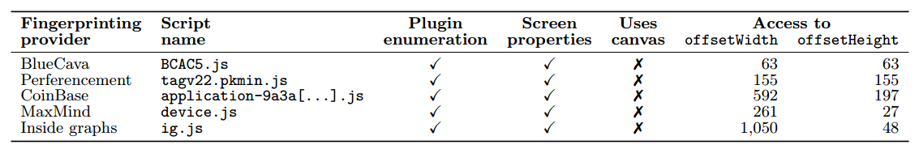
What to misrepresent?
Need to balance fingerprinting prevention with breaking existing sites
For example, navigator.userAgent is a bad thing to misrepresent
Likely to lead to a lot of site breakage
fonts
plugins

Slide 27
Space of randomization policies
Policies for offset measurements
Policies for plugins
For the values of offsetHeight, offsetWidth, and getBoundingClientRect in PriVaricator, we propose the following numeric randomization policies
a) Zero
b) Random(1..100)
+/- 5% noise
The policies are parametrized by the lying threshold (denoted as θ) and a lying probability (denoted as P(lie)).
θ controls how fast PriVaricator starts lying, i.e., after how many accesses to offsetWidth or offsetHeight values, will the policy kick in
P(plug_hide) the probability of hiding each individual plugin in navigator.plugins

Slide 28
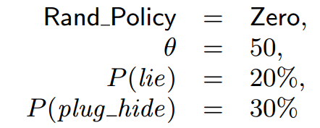
Sample Randomization policy
start lying after 50 offset accesses
respond with the value 0 when lying
only lie in 20% of the cases
hide 30% of the browser’s plugins

Slide 29
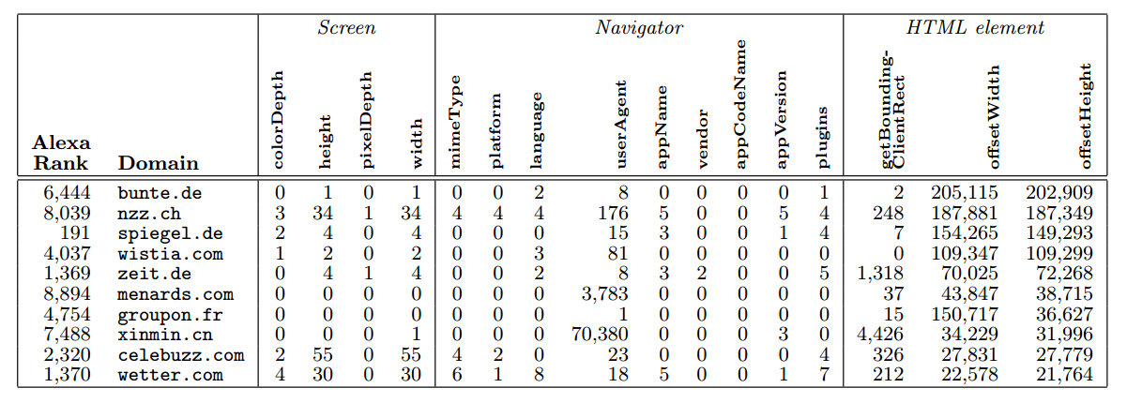
Breakage concerns
Out of Alexa 10,000
1.87% of scripts have 50+ accesses when visited
but don’t want to break spiegel.de
most are ranked pretty low
82.3% of scripts have 0 accesses to offsetHeight

Slide 30
Policy implementation in the browser
Strawman approach
Real implementation
Instrumented access to navigator.plugins at the source level
Try to intercept calls to offsetWidth and offsetHeight using DOM getters
However, it’s difficult to know which element will be measured
offsetWidth and offsetHeight
properties are not part of the HTMLElement prototypе
Instrument access to the properties of interest
Browser changes are, by nature, very
local
Our full prototype involves modifications to a total of seven files in the WebKit implementation of the Chromium
browser, version 34.0.1768.0 (242762)
947 lines of code added/changed

Slide 31
evaluation

Slide 32
Evaluation: dimensions
Performance impact
Effectiveness in breaking existing fingerprinters
Minimizing breakage

Slide 33
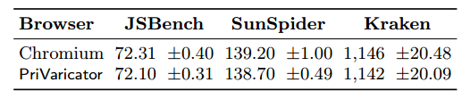
Slowdown? In the noise
Executed each suite five times, clearing the browser’s cache in between runs
The experiments were run on a desktop
machine, running a recent Ubuntu Linux distribution, with an Intel Core i5-3570 CPU @ 3.40 GHz processor, and 8 GB
of RAM
To calculate the upper bound of PriVaricator’s overhead, we used the lying policy with the most computations (± 5% Noise) configured
with the worst (from a performance point of view) parameter settings, i.e., , θ=0 and P(lie)=100%

Slide 34
Is it Effective?
1) BlueCava
  http://bluecava.com/opt-out
  Shows fingerprints such as 18B1-EBFC-A3F0-6D81-6DE8-D8DA-CA56-A22B
2) PetPortal
  http://fingerprint.pet-portal.eu
  Similarly, get a fingerprint
3) Coinbase
  Obtained entirely client-side
  Can be captured
  MD5 applied to it and it’s submitted via a cookie
4) fingerprintjs
  That’s the code we saw earlier
To explore the space of possible policies in
detail, we performed an automated experiment where we visited each fingerprinting provider 1,331 times, to account for 11³ parameter combinations, where each parameter of our randomized policy
  lying threshold
  lying probability, and
  plugin-hiding probability
ranged from 0 to 100 in increments of 10

Slide 35
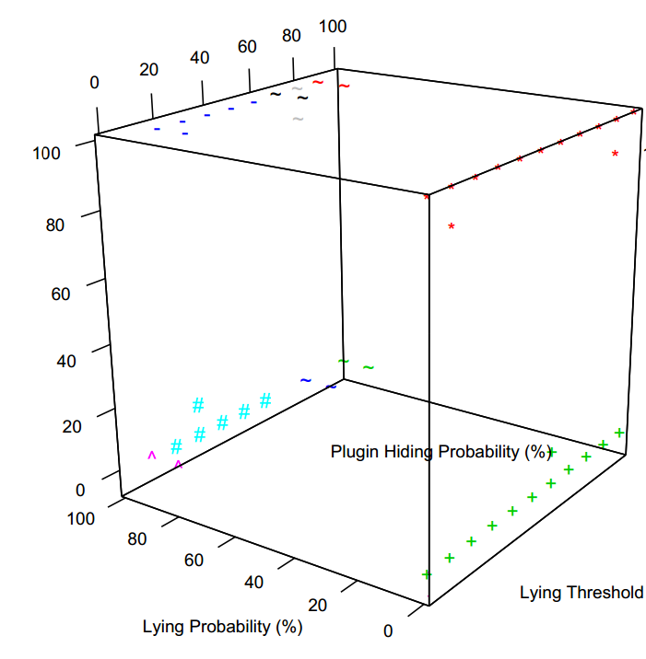
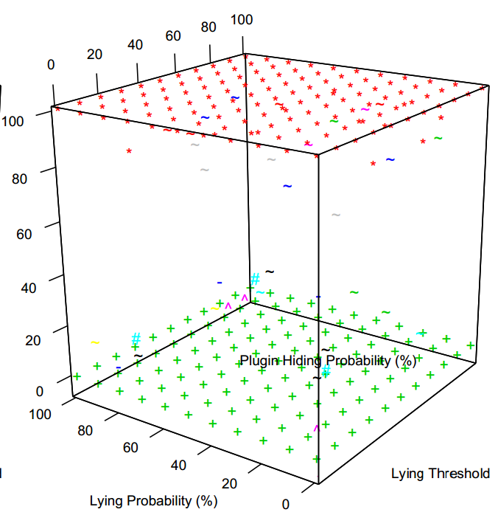
Success of PriVaricator
fingerprint.js
96.32% of all fingerprints are unique
In nearly all intermediate points (78.36% of the total set
of collected fingerprints), randomness works in our favor by returning different sets of plugins, which, in turn, result in
different fingerprints
BlueCava

Slide 36
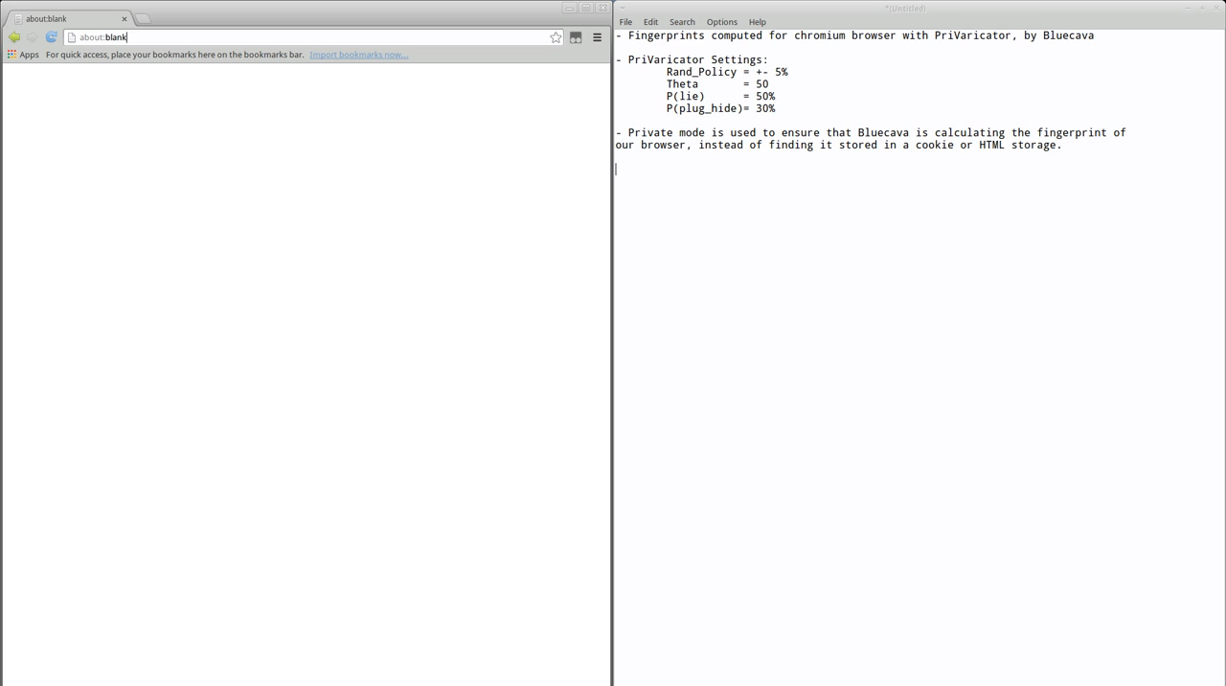
PriVaricator stopping Blue Cava Fingerprinting

Slide 37
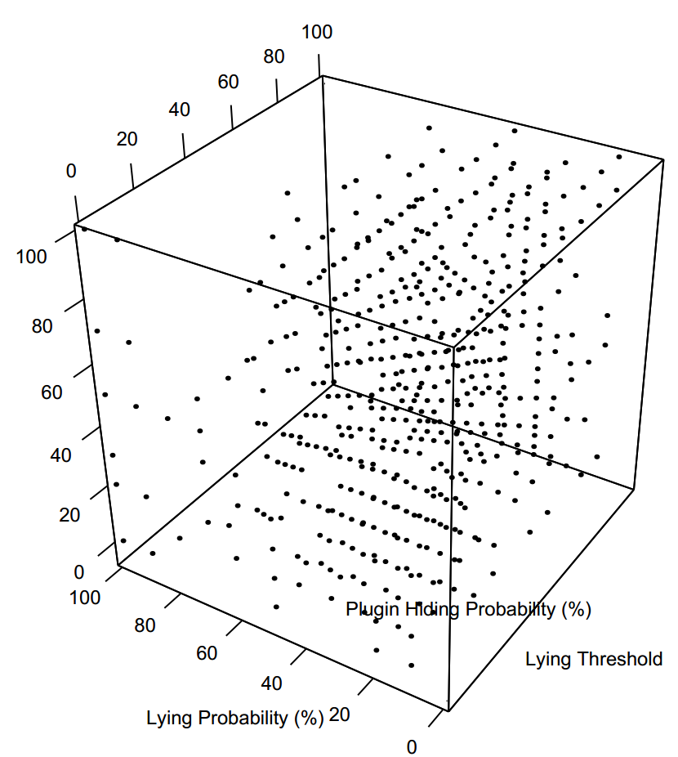
PetPortal: most robust
Range of lying probability of 10-60% is most effective. After 60% it thinks all fonts are present.
To make the results more readable, we show all the configurations that resulted in unique fingerprints, instead of showing clusters of same fingerprints.
Get unique fingerprints for “only” 37.83% of the 1,331 parameter combinations
It is evident that PetPortal succeeds more in tracking us than BlueCava, Coinbase, and fingerprintjs

Slide 38
Measuring breakage
When PriVaricator lies about these values like offsetWidth and offsetHeight, it creates a potential for visual breakage
For example, by reporting that an element is smaller than it actually is, PriVaricator could cause the page to place it in a smaller container, hiding part of its content from the user.
Numerically, we define breakage as the fraction of pixels that are different when a site is loaded with a vanilla browser (PriVaricator turned off) and with PriVaricator
We instrumented Chromium to visit the main pages of the top 1,000 Alexa sites, for 48 different combinations of lying probability and lying threshold; these were the parameter combinations that resulted in unique fingerprints for PetPortal

Slide 39
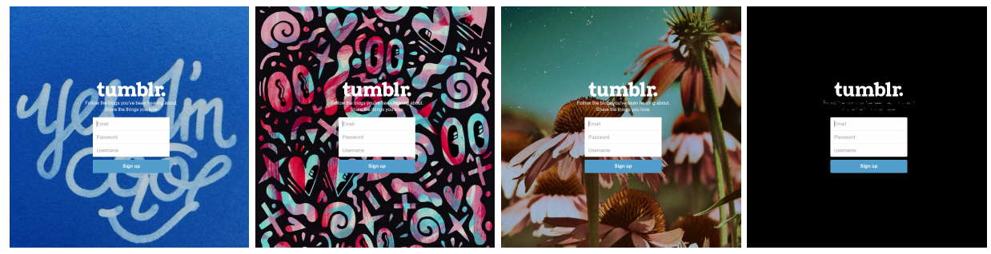
Measuring Breakage by counting pixels
Need to separate breakage caused by PriVaricator from naturally dynamic web pages
Collected a new vanilla-browser screenshot every ten visits of a page, resulting in a total of five extra screenshots
We computed a visual mask of differences appearing on them, and used it when comparing a screenshot captured using a specific policy parameter combination, to the vanilla one
This mask can be applied to all PriVaricator screenshots to exclude the naturally varying parts of a page from subsequent breakage comparisons.
Mask: unchanging page elements

Slide 40
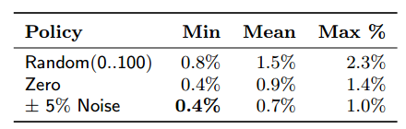
Examining breakage results
Manually reviewed the 100 screenshots with the largest breakage. In only 8 cases, the differences could be attributed to PriVaricator.
In many cases, the sites would show an “in-page” pop-up asking the user to participate in a survey
Next to surveys, the reported breakage was due to missing or not-fully loaded ads, error-pages and image carousels
In one case, PriVaricator had caused a slight stretch of a
site’s background image. While this led to a large computed breakage, users would not notice the change if they could not compare the page with the original non-stretched version.
We likely overestimated the breakage since most of the pages with the highest reported breakage turned out to be false positives.
Overall, the results of our breakage experiments show that the negative effect that PriVaricator has on a user’s browsing experience is negligible.

Slide 41
Challenges
Transparency
Lie cache
We do not claim to preserve transparency in PriVaricator; indeed, this is a tough property to maintain for just about any runtime protection mechanism
A motivated fingerprinter could test for the presence of unexpected randomness, e.g., by inquiring about the dimensions of an element 100 times
A statistical attack may collect multiple
readings and average them over a large number of samples, in an effort to approximate the real measurement
Setting up a “lie cache”, a mechanism where the browser would report the same false value for multiple inquires about the same, unmodified element
To break linkability, the lie cache should be reset at the beginning of every new private mode session, i.e., when a user is opening a private mode tab or window of her browser.
This would enhance the transparency at the cost of linkability within the same private
mode session.

Slide 42
Challenges
Future fingerprinting vectors
Updating policies
Just like with most defense mechanisms, more sophisticated attacks often are developed in response to them.
Note, however, that as long as either plugins or fonts are included as part of a user’s fingerprint and relied upon to provide meaningful information to the fingerprinting party, the current version of PriVaricator is likely to provide adequate randomization
Fluid browser updates enable changing PriVaricator policies
Note that similar updates are shipped to
other browser-hosted security mechanisms such as XSS filters, malware filters, and tracking protection lists (TPLs)
Extensions such as ad blockers also update their blacklists on a regular basis. As such, we feel that PriVaricator provides an extensible platform for stateless fingerprinting defenses

Slide 43
conclusions

Slide 44
Conclusions
PriVaricator: an addition to the browser private mode
Designed to combat stateless tracking or fingerprinting
Negligible performance overhead
Effective for a range of policy parameter values
Breaks quite little (only a handful of sites) in our evaluation

